Slide 1

Scrum #1
Find – Qurrat Ulain

Slide 2


Project Idea Need/Opportunity
This app aims to facilitate the process of finding missing people or those on the run from the police.
The app will have a knowledge aspect to it that will address some of the underlying themes and issues targeting vulnerable people in Regina such as poverty and racism.
This app focuses on promoting peace and inclusive societies for sustainable development and providing access to justice for all, following the 16th UN Sustainable Goal.
As popular research shows, people that are economically and socially disadvantaged are overrepresented among the people reported missing compared to the general population.
This application will not only make it easy for people to get involved in the search for the missing/on the run, but it will also provide them with an easy way to learn about why social exclusion can lead to higher cases of missing persons and what the general population can do to help.

Slide 3
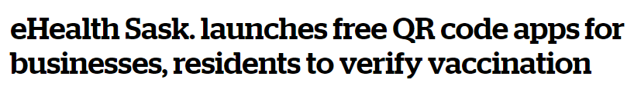
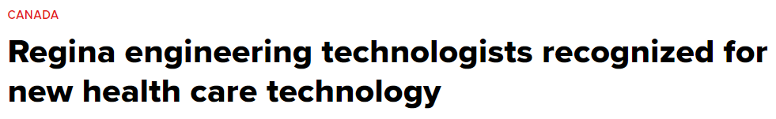
High-level Community’s Characteristics
In general, Regina is stable and adapting
The level of participation in the city is also very diverse, with lots of opportunities to volunteer and different kinds of job opportunities.
The community openness is public, and excited to
Introduce new technology.

Slide 4
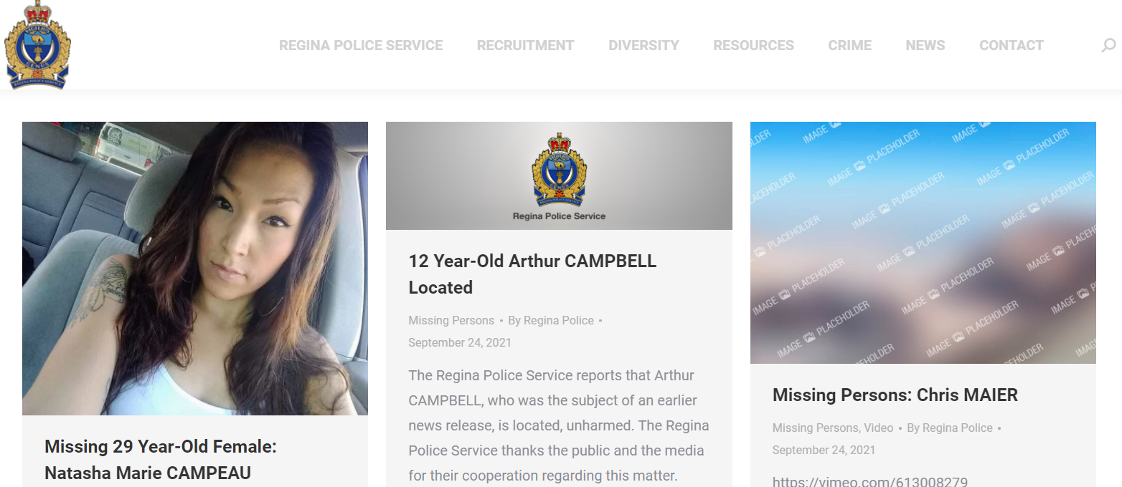
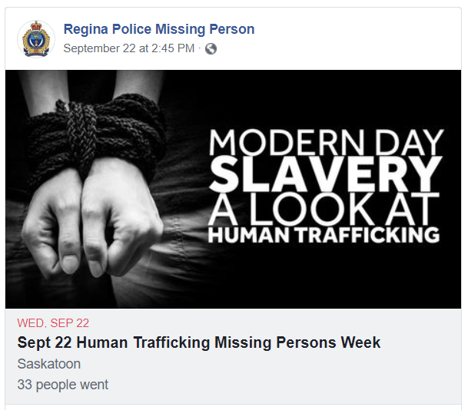
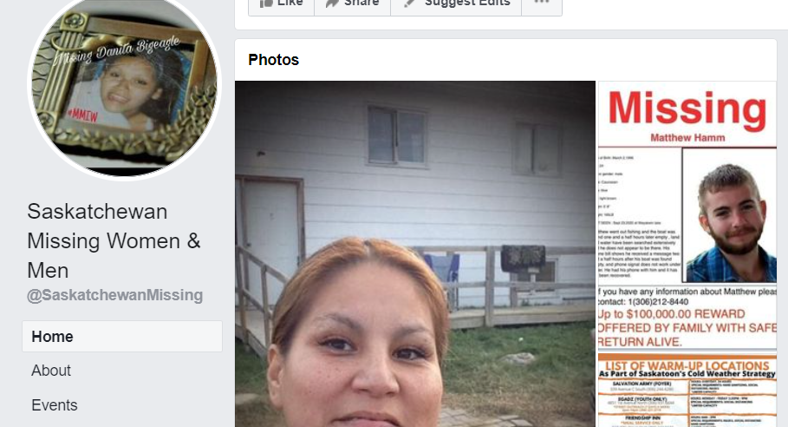
Overview of Existing Platforms and Stand-Alone Tools
Currently multiple different resources for people in Regina to assist in finding missing people.
Facebook groups either not updated often or too broad of a focus area
Websites aren’t as accessible, inconvenient to navigate to on smartphone devices
Mobile app exists, but focused broadly on Canada and only for missing children

Slide 5
Overview of Evolved and Focused Stakeholders
Tim Maciag – Project Sponsor and Mentor
Regina Police – Potential Sponsor
Possible other Missing Person’s Organizations in Regina/Saskatoon
Customers: General public of Regina – focused more people that regularly use their phone outside

